Slide 1
INTERNET OF THINGS - INTRODUCTION
LESSON 1
Mentors-
Shalini Jha
Jivansha Gupta

Slide 2
WHAT IS IOT?
Internet of Things
Different things connected together through a network
A connection of sensors, database, cloud
The Internet of Things (IoT) is the network of physical objects—devices, vehicles, buildings and other items embedded with electronics, software, sensors, and network connectivity—that enables these objects to collect and exchange data.
Machine to Machine communication

Slide 3
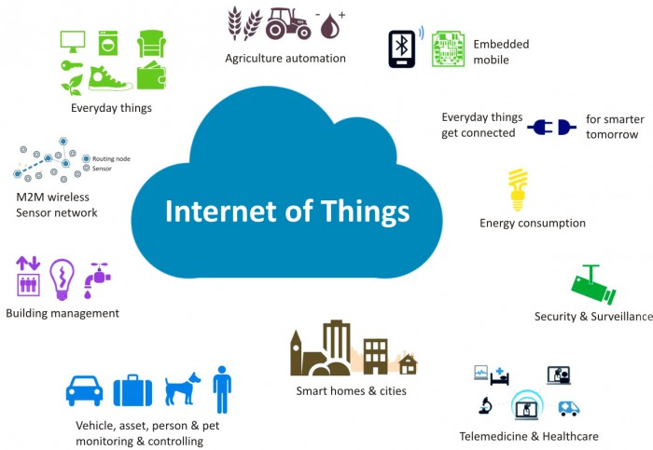
HAVE YOU SEEN IOT?

Slide 4
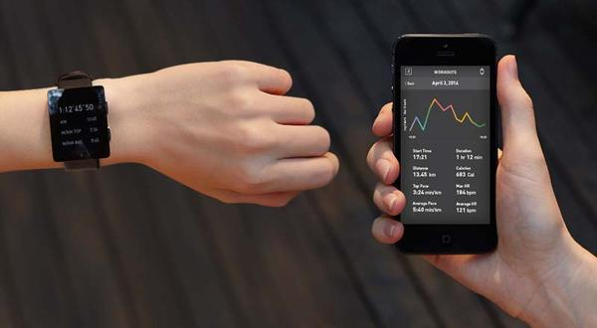
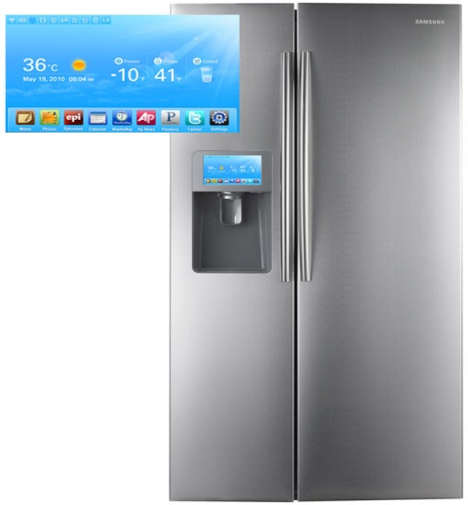
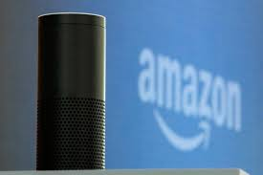
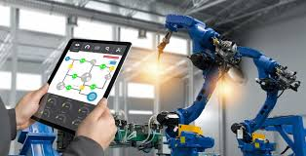
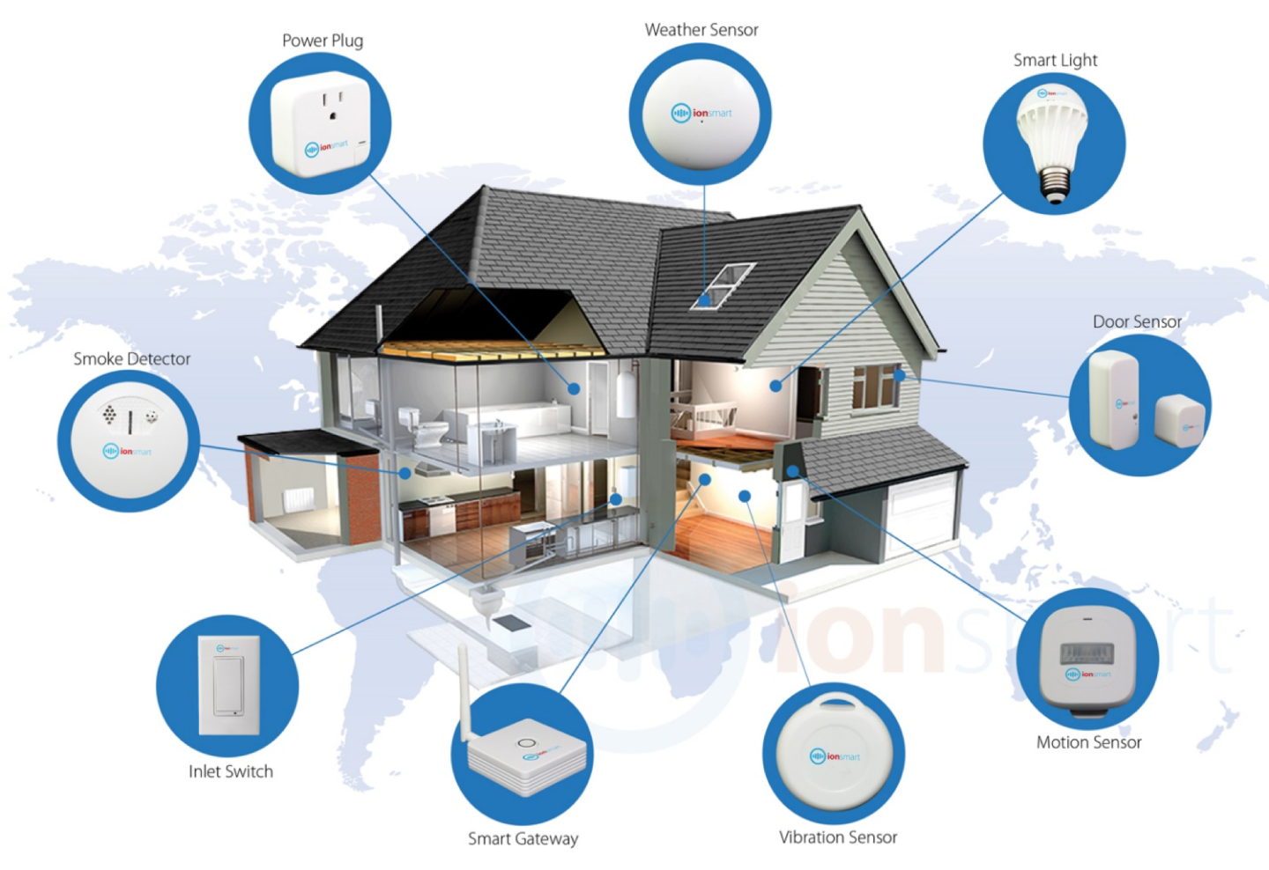
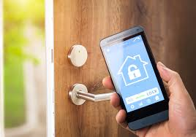

Slide 5
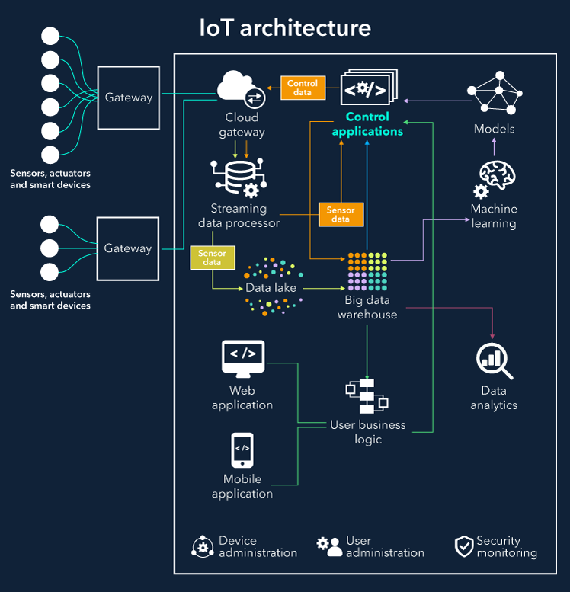

Slide 6
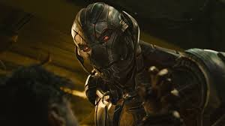
THREATS
Hacking
Network Failure
Privacy
Ultron
GOOD CYBER SECURITY

Slide 7
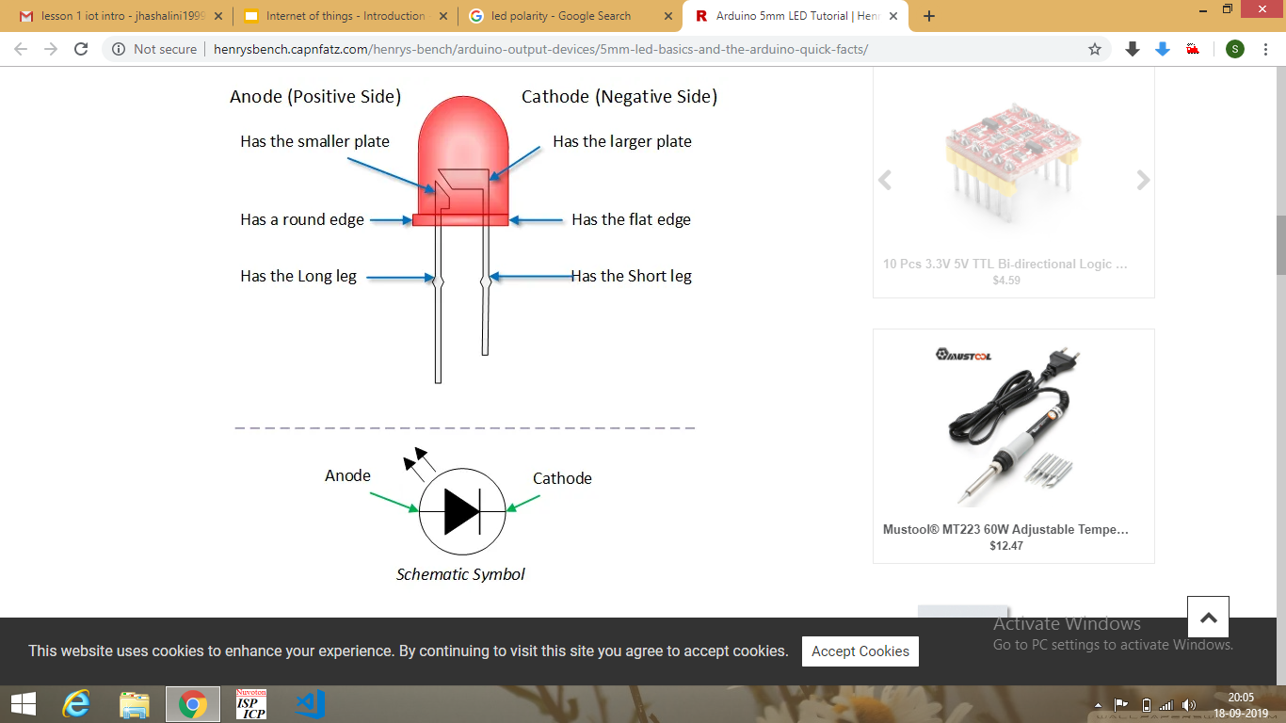
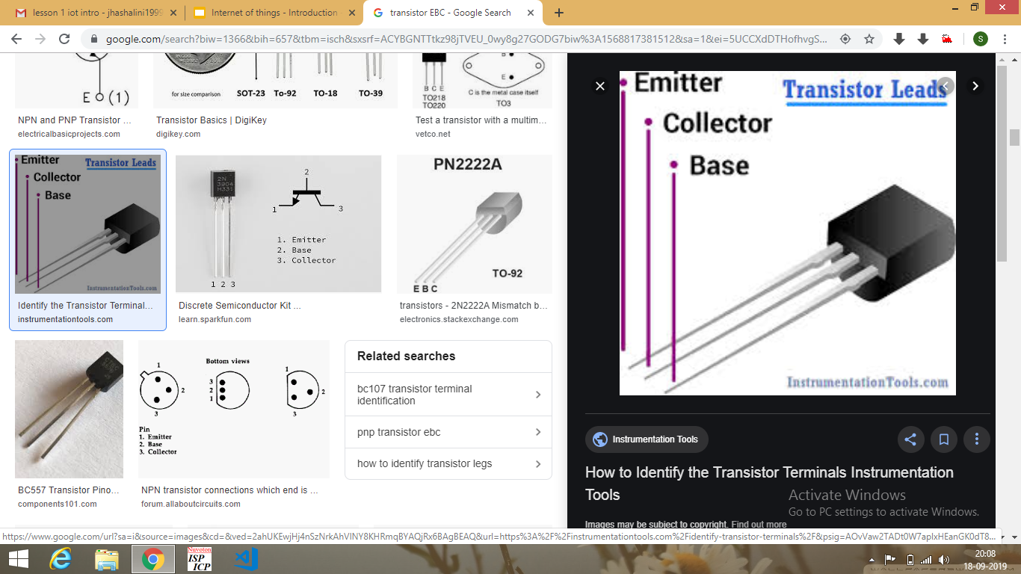
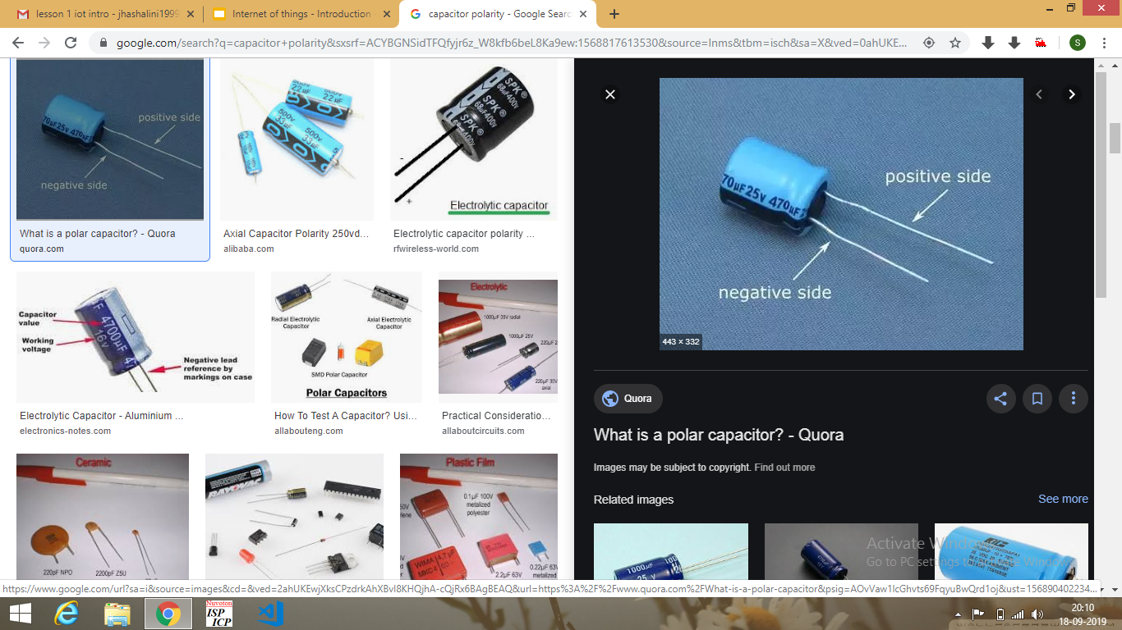
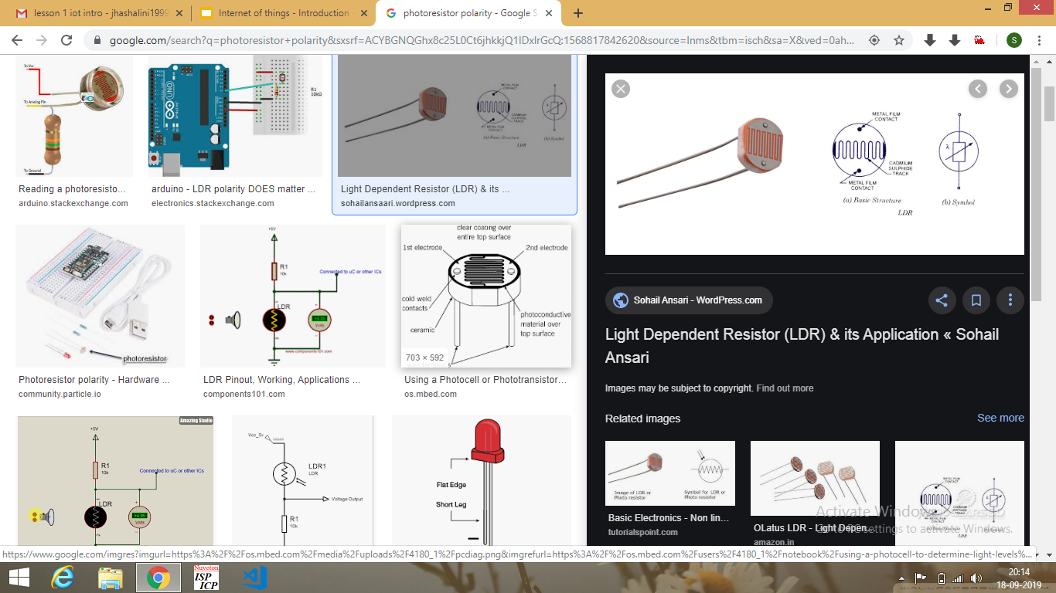
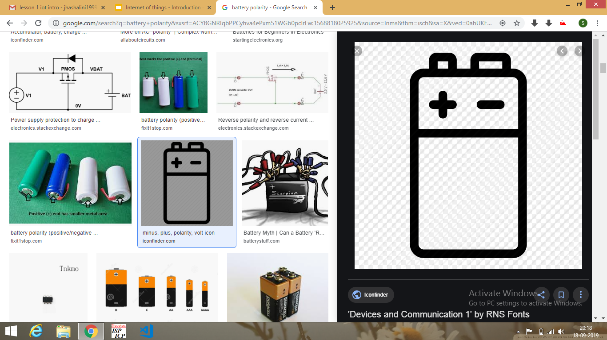
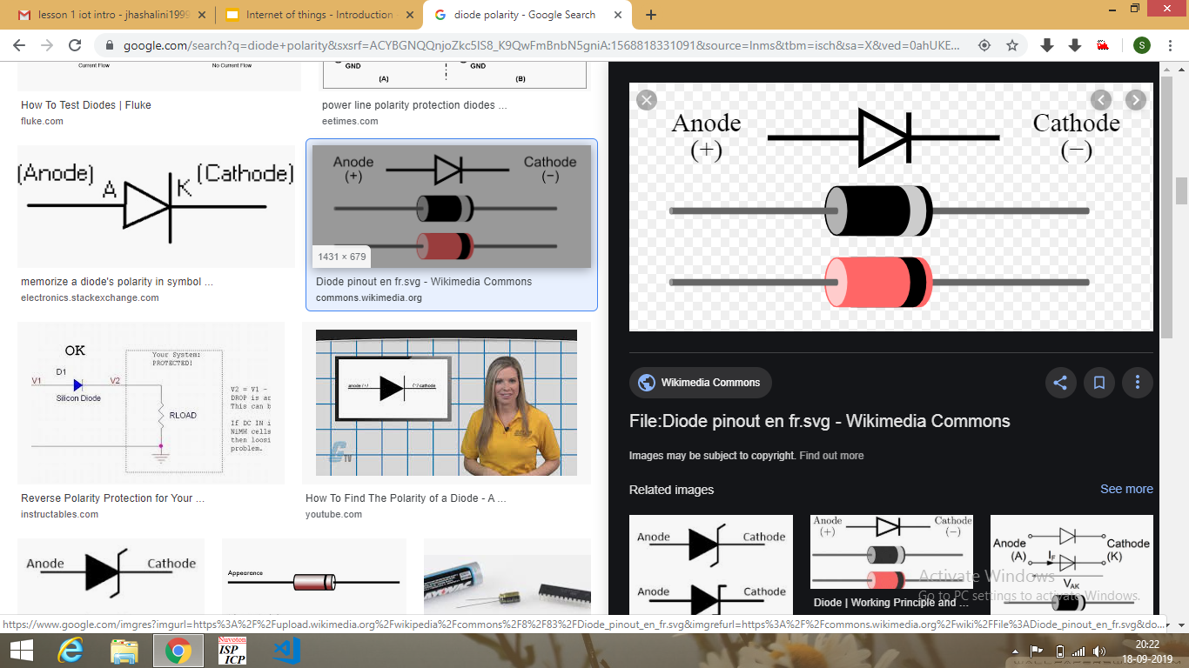
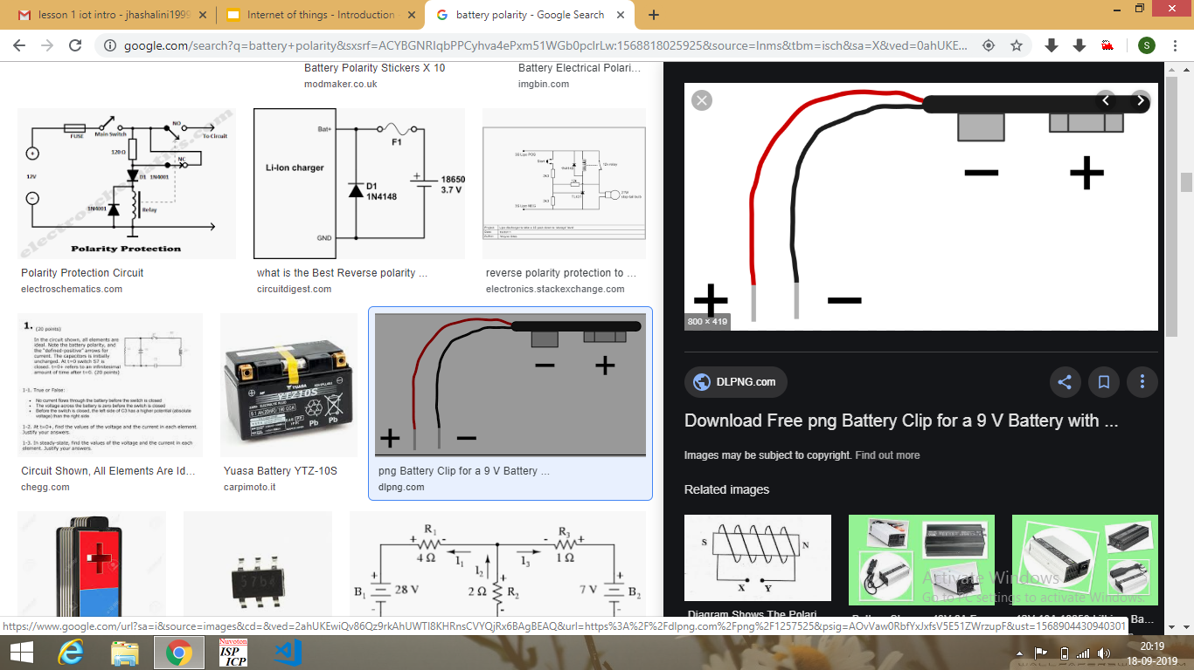
Some Basic Electronic Components-

Slide 8
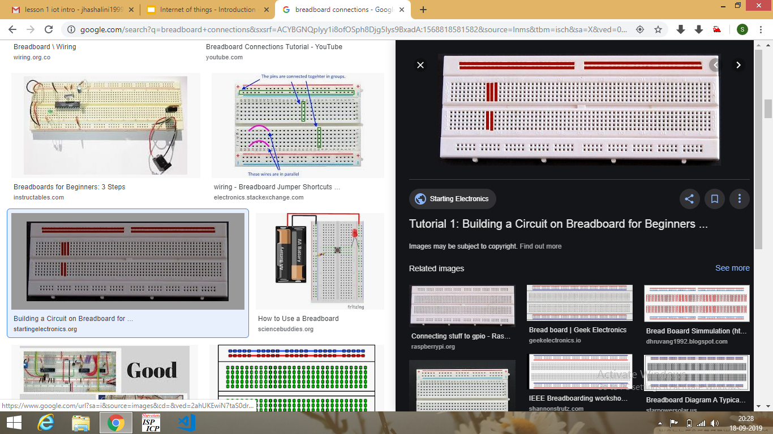
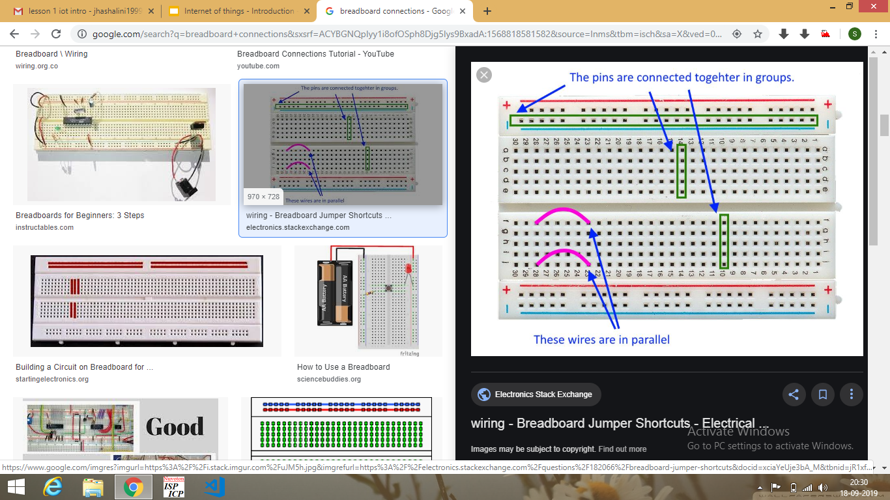
Breadboard Connections

Slide 9
Let’s Start Tinkering
Glow an LED with 9V Battery
Insert a photoresistor between LED and Battery.
Faced any problem???
Control the LED brightness using photoresistor and transistor but no ARDUINO/NODEMCU ( the brightness of LED should be max when the light incident on the photoresistor is minimum)

Slide 10
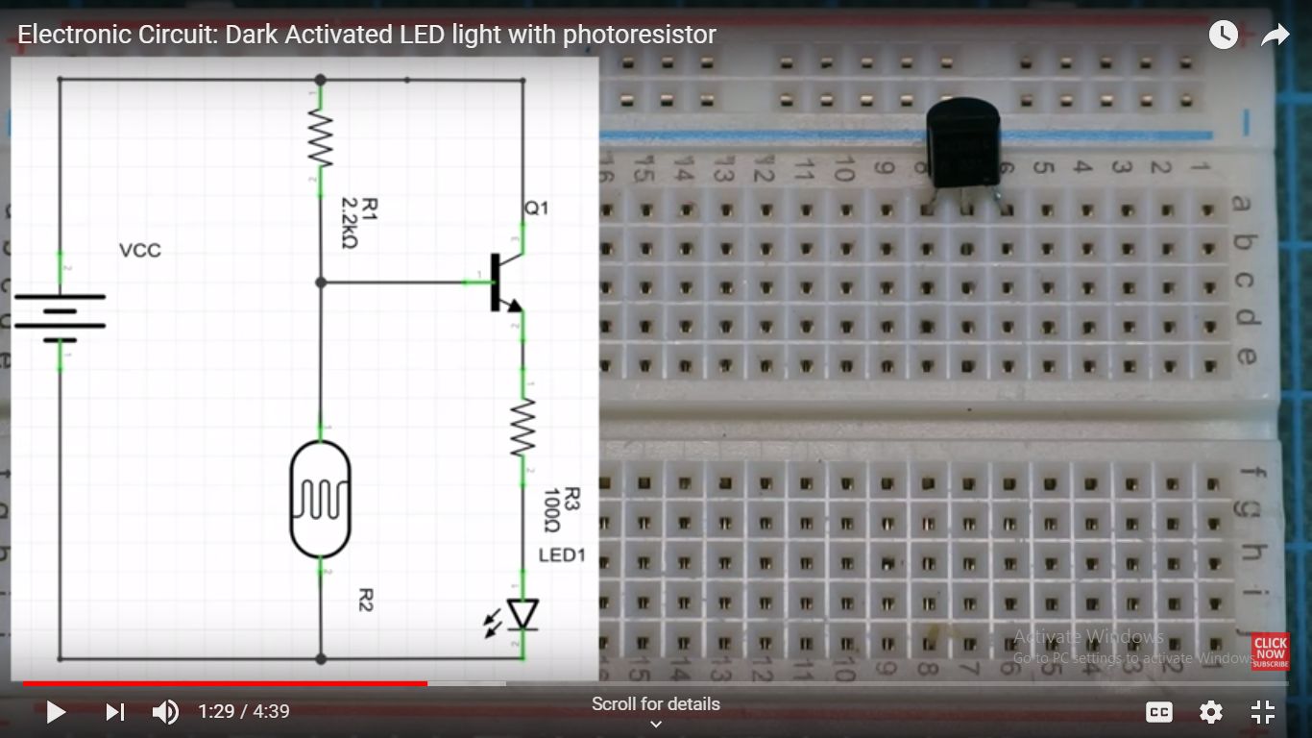
Circuit Diagram for 3rd Task-

